Slide 1
JEE Overview

Slide 2

Agenda
Define three-tier architecture
Define Model-View-Controller (MVC) architecture

Slide 3
JEE Architecture
Java EE platform for developing server side application using java
Set of coordinated technologies that significantly reduces the cost and complexity of developing, deploying, and managing multitier, server-centric applications.
Released to ease the development and make the coding simpler.
Simplifies the development process through the use of Java Annotations, POJO bases programming and resource injection concepts

Slide 4
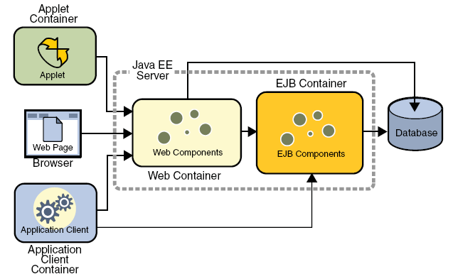
JEE Architecture (cont.)

Slide 5
Java EE Container Services
Deployment based services:
Persistence
Transaction
Security
Injection
Inherent services:
Life-cycle
Threading
Remote object communication, such as RMI and CORBA

Slide 6
Java EE Container Services
Vendor Specific Functionality
Scalability
Failover
Load balancing

Slide 7
Java EE Container Services
API-based services:
JDBC, JNDI
RMI-IIOP (Internet Inter-ORB Protocol)
JavaMail API and JAF
Java EE Connector Architecture
JMS API, JTA
JAAS (Java Authentication and Authorization Service)
Java API for XML Processing (JAXP)

Slide 8
Java EE Container Services
Web Services
Simple Object Access Protocol (SOAP)
Java API for XML Registries (JAXR)
JAX-RPC
JMX
Timer Services

Slide 9
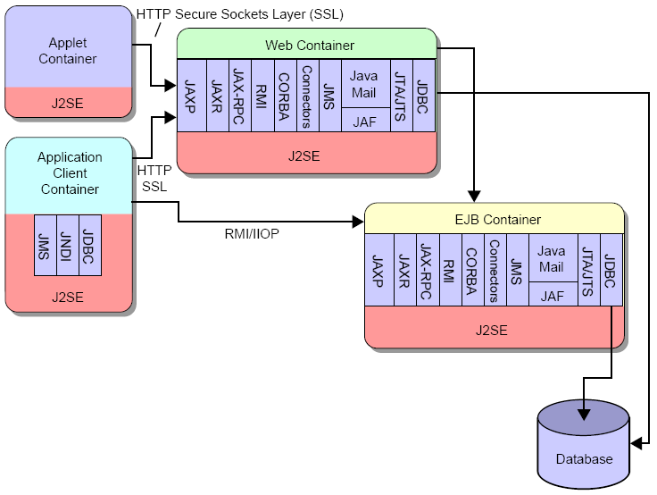
Java EE Service Infrastructure
API-based services:
JDBC, JNDI
RMI-IIOP (Internet Inter-ORB Protocol)
JavaMail API and JAF
Java EE Connector Architecture
JMS API, JTA
JAAS (Java Authentication and Authorization Service)
Java API for XML Processing (JAXP)
Web Services
Simple Object Access Protocol (SOAP)
Java API for XML Registries (JAXR)
JAX-RPC
JMX
Timer Services

Slide 10
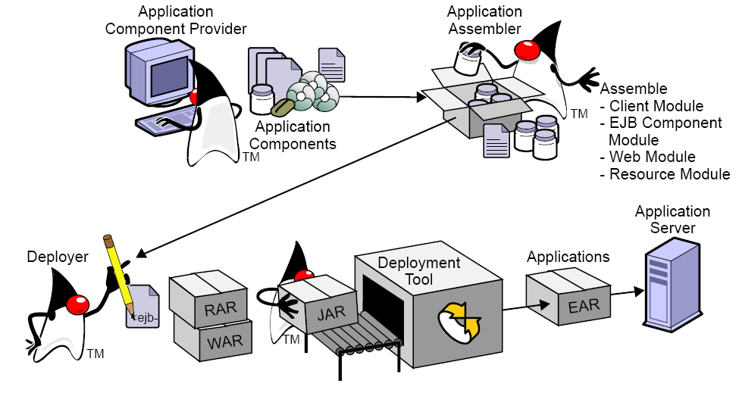
Java EE App Development process

Slide 11
MVC application Overview
Isolation of Concern
Model contains application logic
View contains UI Layer
Controller support interaction

Slide 12
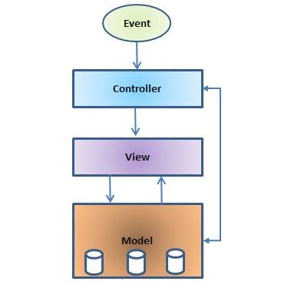
MVC Architecture

Slide 13
Benefits of MVC
Substitutable UI
Different View technology can be implemented
No Effect on business Layers
Ease of UI maintenance
Easier Testing
Can test Each Layer in Isolation
Layered Approach
Ease of Maintainability

Slide 14
Benefits of MVC
Platform Independence
Different UI Platforms
Same Logic for All Platforms
Only UI Layer changes
Ease of up gradation and Change
Easily upgraded to higher version
Ease of Change

Slide 15
Drawback of MVC
Increased Complexity
Application becomes hugely complex unless a proper framework is chosen.
Increase Development Time

Slide 16
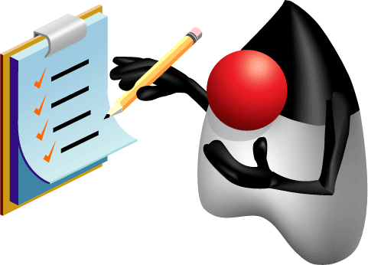
Summary
Java EE ?
Application Architecture
Container Services
Service Architecture
Application Development Process
MVC

